Slide 1
Future state ATC integration services architecture POV

Slide 2
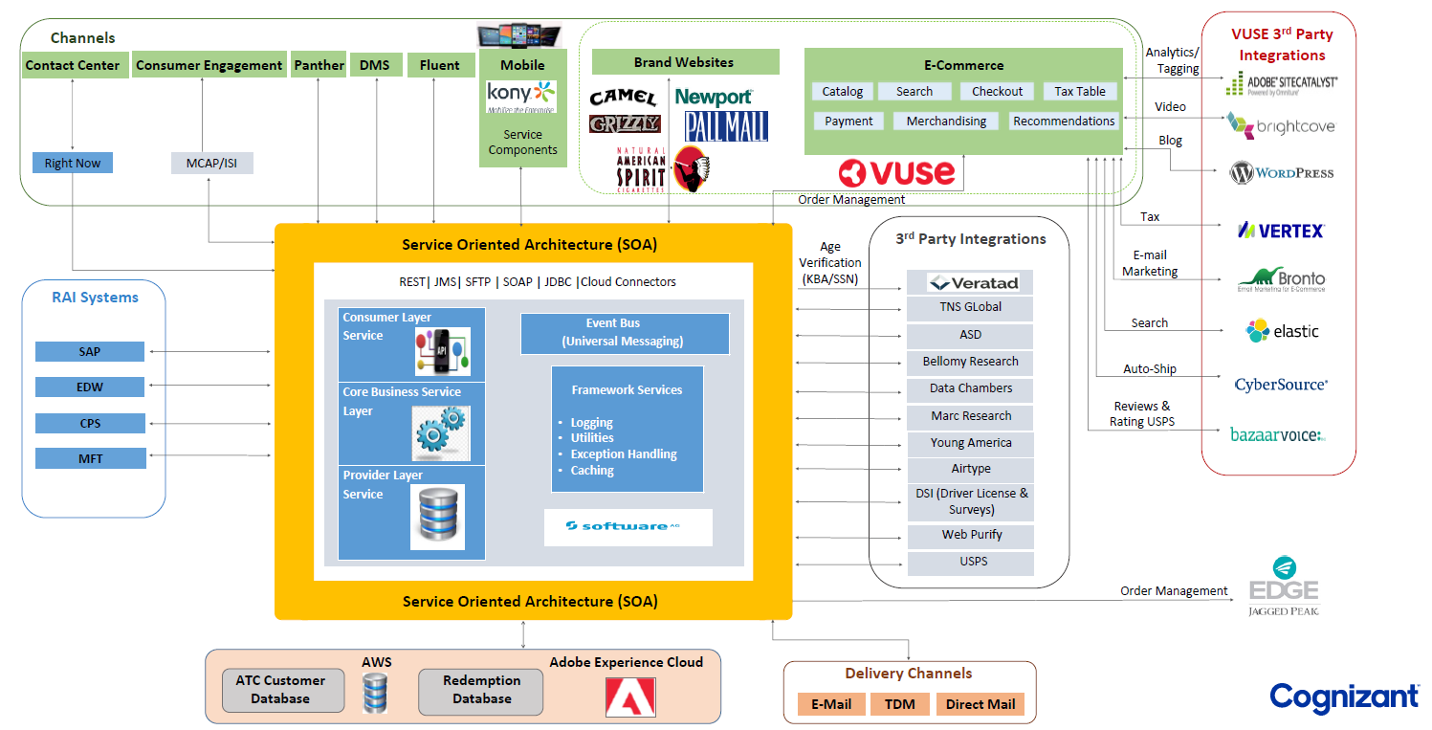
Overview of the Current State Landscape – Webmethods as primary integration middleware
Key Pain Points
Expensive to scale the existing platform considering volume, velocity and variety of data
Support for futuristic digital use cases requiring big data transfer, streaming in the existing WebMethods platform in a cost efficient manner
Many point to point integrations developed over years as per project needs without CoE governance
Support for faster innovation (Homogeneous ecosystem and managed open source services)

Slide 3
Current state ATC integration architecture view
Constraints
Expensive to scale
Lack of agility for faster innovation
Cost prohibitive to adopt modern technologies
ATC integrations by numbers in prod
81 Inbound interfaces to ATC
51 batch
30 realtime (REST/SOAP & JDBC adapters)
14 Outbound interfaces from ATC
All integrations are through webMethods
1 point to point interface

Slide 4
Questions on future state architecture direction
We understand that vision is to replace ATC with AEP.
Is there any fitment analysis exercise being done by RAI/BAT
Have you identified any functionalities that can not be implemented through AEP and need custom build solution specific to RAI/BAT
Are there any critical functionalities within ATC that has been prioritized for modernization
AWS provides some ETL and batch processing as managed services; are you planning to leverage these cloud native services for ATC batch integration use cases

Slide 5















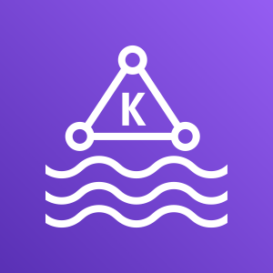


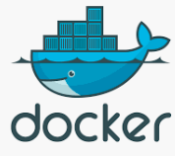
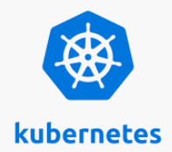





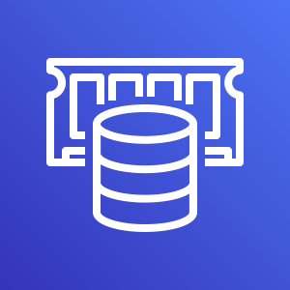



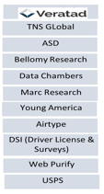










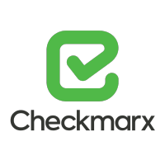






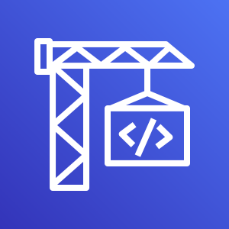






Future State Enterprise Integration Architecture Vision
3rd party apps / partner collaboration
Channel Applications
Enterprise Applications
eCommerce Platforms
Consumer Engagement
Mobile
Apps
Email
Panther
DMS
Fluent
Call center
RAI Branded Websites
SAP ERP
VUSE 3rd party Integrations
Amazon
CloudFront
AWS Elastic
Load Balancing
API Gateway/Mgmt
Amazon API Gateway
Amazon
Route 53
SAP PI
API Gateway
CDN
Service Routing
CRM
Message routing & Process Orchestration
AWS SNS
AWS
Managed Kafka
CRM Adapters
AWS Step Function
Business rules Mgmt.
Message Routing
Process Orchestration
Services & Data Integration
AWS Elastic Kubernates Service
AWS
Lambda
AWS
RDS
AWS
DynamoDB
AWS
Elasticache
AWS
Batch
AWS Glue
AWS Data
Pipeline
EDW
Platform services
Micro services
Data Fabric
Data Integration Hub
CPS
3rd party Integrations
Cross Cutting Concerns
MFT
AWS
CloudWatch
AWS
Trusted Advisor
AWS
ELB
AWS
Auto Scaling
AWS
IAM
AWS
Cognito
AWS
X-Ray
AWS
Budgets
AWS
Cost Explorer
AWS
Trusted Advisor
Other Patterns..
Performance & Resiliency
Scalability
Security
Cost
MFT / SFTP / JDBC / ODBC / RPC
Data Lakes / Big data??
AWS SNS
AWS Mgmt. Console
AWS
CloudTrail
Amazon
CloudWatch
AWS CodeCommit
AWS CodeBuild
AWS CodeDeploy
AWS CodePipeline
AWS
CloudFormation
ATC DB
Logging / Monitoring / Auditing/Alerting
DevOps
Hybrid Infrastructure
Redemption DB

Slide 6
ATC future state integration architecture – our view

Slide 7
Next steps
Due diligence workshops with RAI/BAT to understand ATC capabilities, priorities and modernization vision

